Slide 1
AFTER THE STORM
Changing the Conversation, Maintaining Engagement
Racheal Borgman, Communications Specialist | RBorgman@grta.org

Slide 2
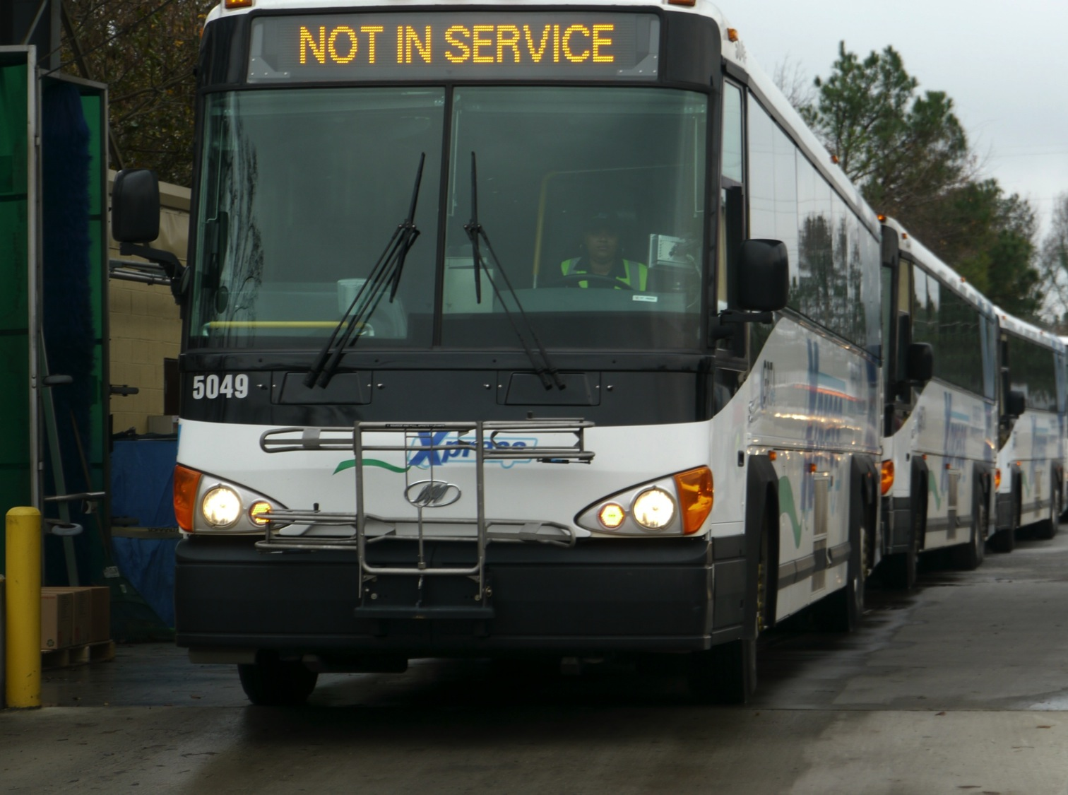
Rapidly changing service capabilities
Riders unused to seeking service communications
Limited time and information
COMMUNICATION CHALLENGES

Slide 3
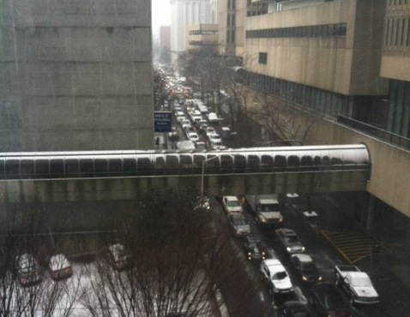
+ 259%
+ 25%
+ 24%
A NEW AUDIENCE

Slide 4
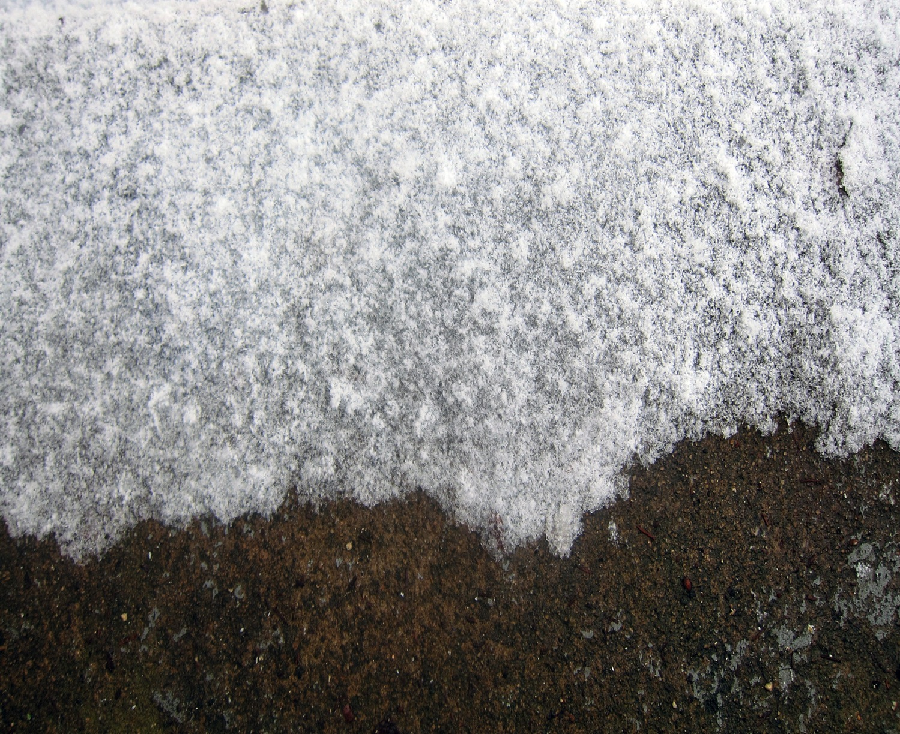
Encourage proactive information-seeking
Develop a sustainable community
PRIORITIES FOR NEW ENGAGEMENT

Slide 5
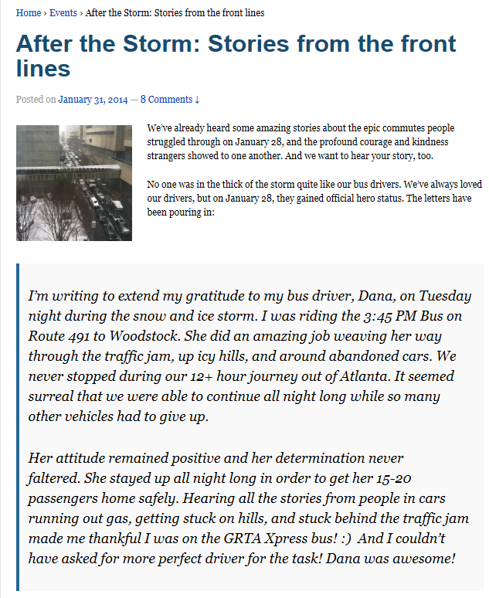
Solution #1:
Invite gratitude and cultivate a positive focus

Slide 6
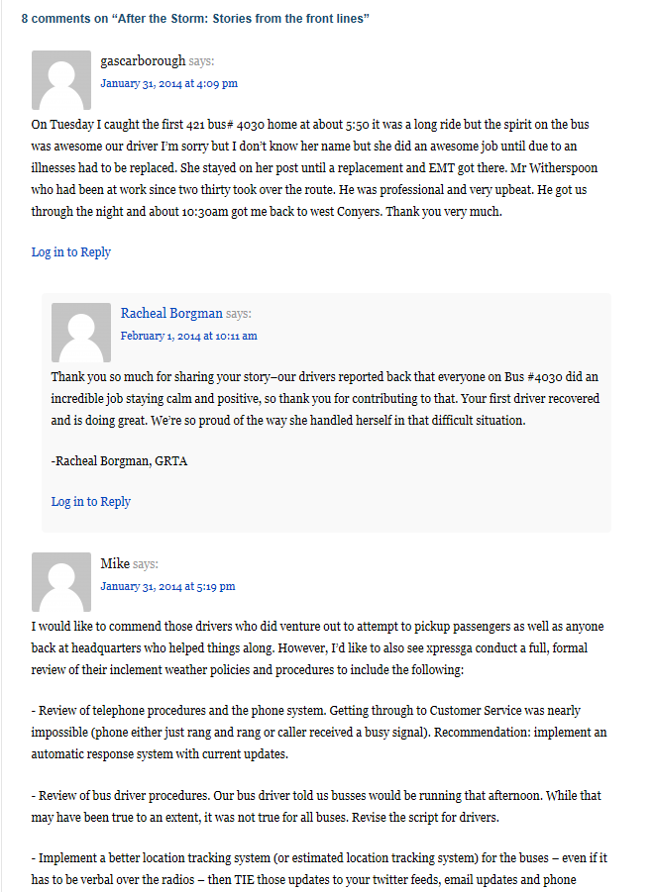
…while providing a safe space for riders to share experiences

Slide 7
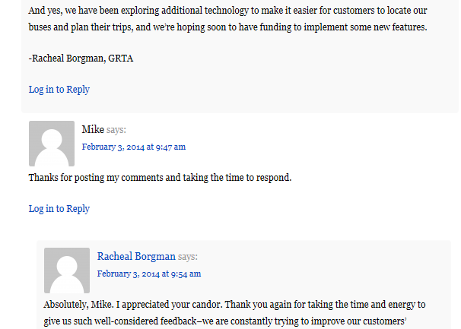
…and allowing us to respond.

Slide 8
Give them more, faster.
Give them more right away.
Give them more, more frequently.
LESSONS LEARNED

Slide 9
XpressGa.com
blog.XpressGa.com
Twitter.com/XpressGa
Racheal Borgman, Communications Specialist | RBorgman@grta.org

