Slide 1
G
E
M
A
Georgia Emergency Management Agency Office of Homeland Security
Social Media in Crisis Communications

Slide 2
THANK YOU
to all who supported GEMA Public Affairs
last winter

Slide 3
What is GEMA?
GEMA coordinates state activities that help save lives, protect property and reduce suffering of Georgia residents and communities impacted by disasters through a variety of disaster preparedness, response, recovery and mitigation initiatives.
State Communications Center open 24/7

Slide 4
Georgia Emergency Operations Plan
Contains specific Emergency Support Functions
Each ESF has a primary state agency responsible for developing standard operating procedures in coordination with other supporting agencies
Governor’s Office and GEMA are the primary agencies for ESF-15
Crisis communications plan is our road map
There are approximately 28 support agencies
Support includes subject-matter experts, PIOs

Slide 5
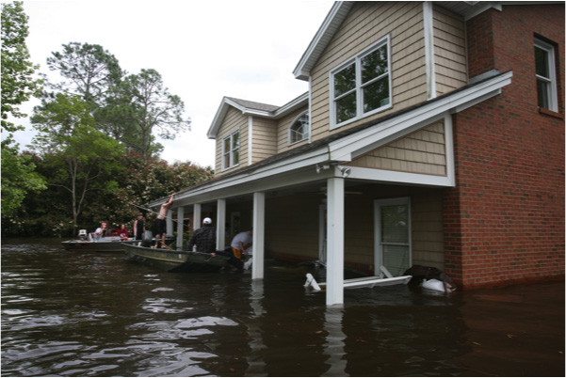
Crisis Communications
Communicating the right information to the right people at the right time so they can make the right decisions

Slide 6
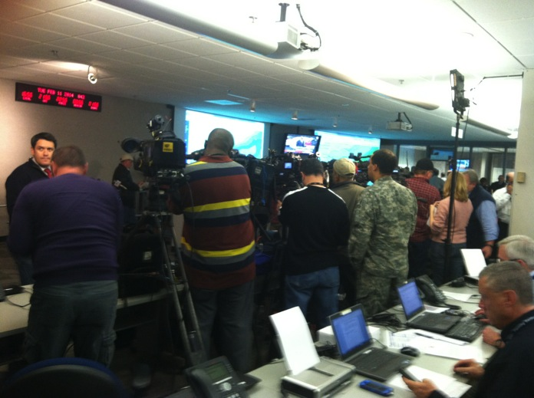
During a Disaster or Emergency
Public wants to know …
What happened?
Is state government responding appropriately?
What actions do you want the public to take?
Social media has created greater demand for real-time information

Slide 7
Coordinating Communications
ESF-15 – Joint Information System
The method of operating during an incident that allows multiple PIOs to coordinate information and integrate messages to avoid confusing the public
Could be as simple as two PIOs talking on the phone about an incident that involves both of their agencies or many PIOs working from several locations
Allows for consistent messaging across multiple jurisdictions and/or disciplines, volunteer organizations and the private sector

Slide 8
ESF-15 – JIS Coordination
During an emergency, GEMA may:
Call upon ESF-15 for additional external affairs support
Work with local, state and federal officials to establish a Joint Information Center (JIC), a central location to facilitate the flow of news releases, press conferences, fact sheets, and other information
One-stop shopping for the media
Reduces misinformation, gives “one voice” for the event
Agencies do NOT lose their individual identities or responsibility for their own programs or policies

Slide 9
JIC Duties
Respond to media inquiries
Gather information
Disseminate information (update website, write press releases, social media)
Coordinate press conferences/secure interpreter
Monitor media
Travel to affected area to support local EMAs and/or escort VIPs
Respond to constituent inquires
Photographer

Slide 10
Role of Social Media in JIC
Send preparedness information before an event
Official source of information during incident
Watch trends to shape messaging
Rumor control
Pin important information to the top of your page

Slide 11
Social Media Channels Used by GEMA
Twitter
@GeorgiaEMA
Facebook
www.facebook.com/ReadyGA
www.facebook.com/GEMA.OHS
Flickrwww.flickr.com/photos/georgiaema
YouTube
www.youtube.com/ReadyGAfromGEMA

Slide 12
Remember …
Everyone is a reporter, including your staff
Check platforms where you don’t have an official presence
Make sure they know policies regarding who can speak on behalf of your agency applies to social media
Reddit AMA

Slide 13
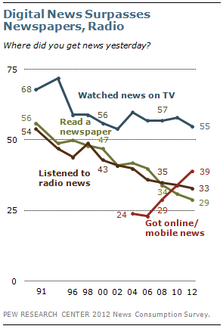
Pew Research Study
Where Did You Get Your News Yesterday Study
TV is declining but still king: Most people still get info from TV
19% got news from a social networking site
For adults younger than 30 …
34% watched TV news
33% saw news on a social networking site
13% read a newspaper in print or digitally

Slide 14
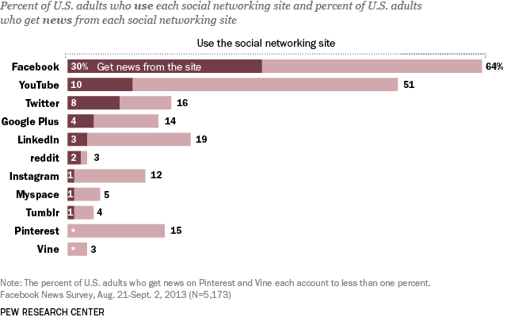

Slide 15
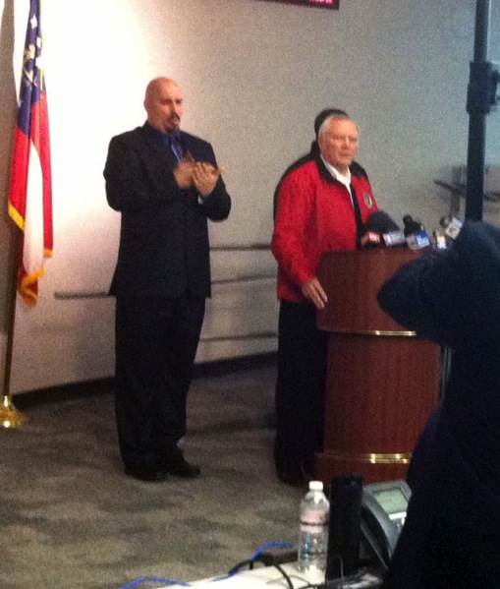
Social Media Just One Tool
Have to reach whole community
Real-time maps AND pdfs
Considerations for vulnerable populations
Interpreters
Consider power outages
Mobile websites
Radio

Slide 16
Which winter storm was worse?

Slide 17
Perception is Everything
February Winter Storm by the Numbers
Five fatalities
1 million customers lost power
70,000 acres of trees impacted: Chainsaw strike teams from Georgia Forestry Commission, the Department of Natural Resources and the Georgia Department of Corrections completed over 1,200 missions
GEMA coordinated nearly 300 resource requests

Slide 18
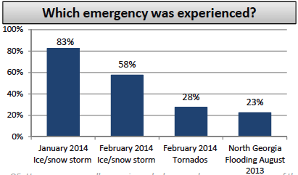
Perception is Everything
Source: 2014 Ready Georgia survey

Slide 19
Lessons Learned
Preparedness tweets with specific tips sent every hour
Twitter Alert
Winter storm warning sent to cell phones; special message went out on Ready Georgia app
GIS map with shelter locations, warming centers
Digital billboards
Website redesign underway
Winter Weather Awareness Week is Dec. 8-14, will have an exercise component

Slide 20
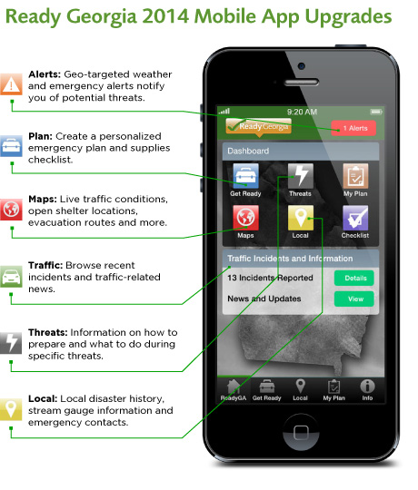
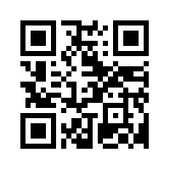
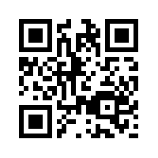
Android QR Code
iPhone QR Code

Slide 21
Lisa Janak Newman
(404) 635-7019
lisa.janak@gema.ga.gov

